Slide 1
HELLO MY NAME IS SIBHA PATAIT

Slide 2
INTRODUCTION
IN THIS PROJECT I HAVE UTILIZE SQL QUERY TO SOLVE A QUESTIONS THAT ARE RELATED TO PIZZAS SALES

Slide 3
SQL QUERY OF PIZZA SALES

Slide 4

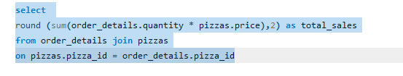
Calculate the total revenue generated from pizza sales.

Slide 5
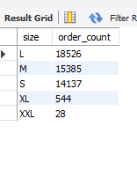
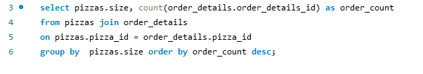
-- Identify the most common pizza size ordered.

Slide 6
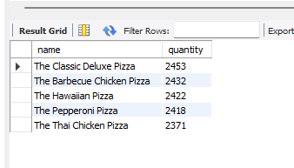
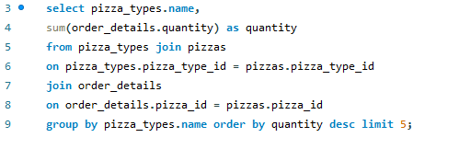
List the top 5 most ordered pizza types along with their quantities.

Slide 7
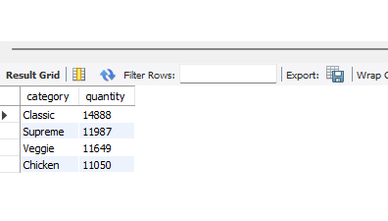
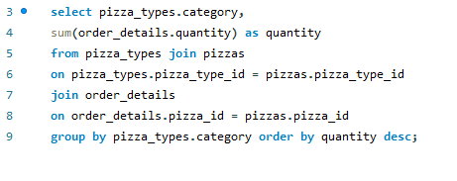
Join the necessary tables to find the total quantity of each pizza category ordered.

Slide 8
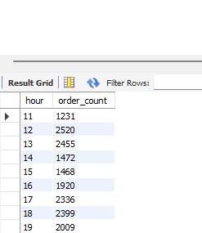
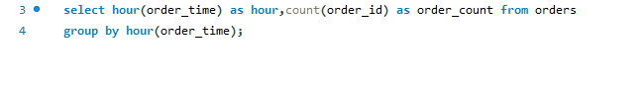
Determine the distribution of orders by hour of the day.
.

Slide 9
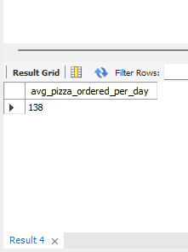
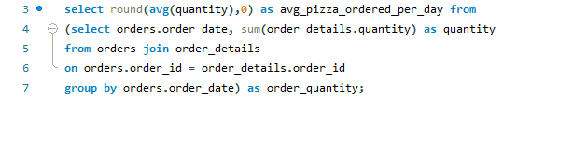
Group the orders by date and calculate the average number of pizzas ordered per day.

Slide 10
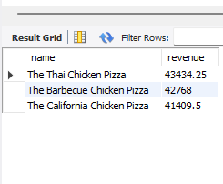
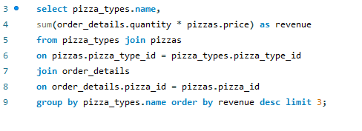
-- Determine the top 3 most ordered pizza types based on revenue

Slide 11
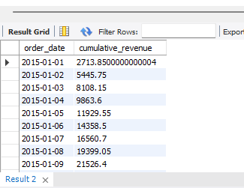
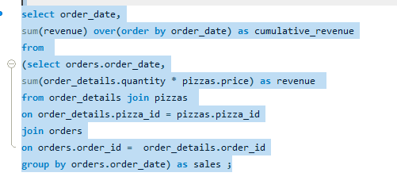
-- Analyze the cumulative revenue generated over time.

Slide 12
Thank you

